Slide 1
Towards Decision Support and Goal Achievement: Identifying Action-Outcome Relationships From Social Media
Speaker: Jim-An Tsai
Advisor: Jia-ling Koh
Author: Emre Kıcıman, Matthew Richardson
Date: 2015/10/29
Source: KDD’15

Slide 2
Outline
Introduction
Method
Experiment
Conclusion

Slide 3
Motivation

Slide 4
Purpose

Slide 5
Framework

Slide 6
Outline
Introduction
Method
Experiment
Conclusion

Slide 7
Major types of Question
1. Choice Exploration
If we choose a query such that E+ selects a specific action (and E- selects an inverse action or null action), then the results from our analysis will identify what is likely to happen after taking the specified action.
2. Goal Achievement
If instead we choose a query such that E+ selects the achievement of a specific goal (and E- selects the non-achievement of that goal), then the precedents identified by our analysis will identify what is likely done and differentiates between people achieving the goal and not achieving it.

Slide 8
Subproblem
1. Identification of experiential messages
2. Timestamping event occurrences
3. Recognition and canonicalization of events
4. Identification of precedent and subsequent
5. Identification of positive and negative valence of events

Slide 9
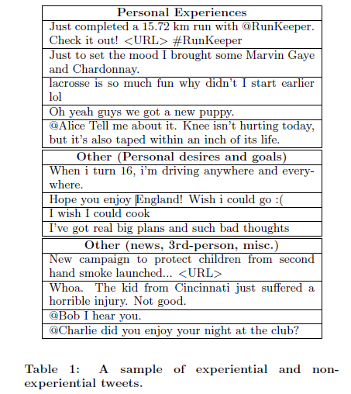
Identification of experiential messages

Slide 10
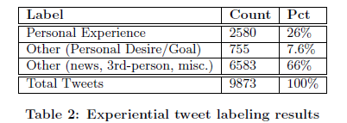
Identification of experiential messages
We train a naive Bayes classier on these labeled messages, using maximum likelihood estimation for the NB parameters.

Slide 11
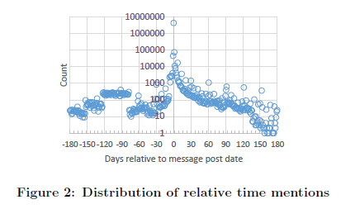
Timestamping event occurrences

Slide 12
Recognition and canonicalization of events
1. Phrase Segmentation
We use a statistical modeling approach to infer the hidden phrase boundaries in a text.
Below are segmentations of 2 sample messages:

Slide 13
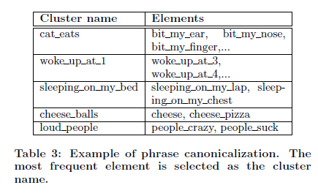
Recognition and canonicalization of events
2. Canonicalization
Generally speaking, there are many alternative ways to describe or report on a personal experience when writing a social media message, leading to the need to identify and canonicalize phrases with substantially the same meaning.

Slide 14
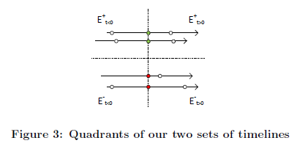
Identification of precedent and subsequent
1. Correlational Analysis
Our goal in this analysis is to find events that are more correlated with occurring before or after E+ (but not both before and after) than occuring before or after E-.

Slide 15
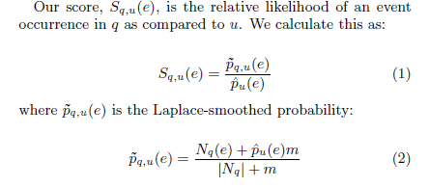
Identification of precedent and subsequent
Defining the pair-wise comparison of likelihoods of an event occurrence between a target quadrant q and a neighboring quadrant u.

Slide 16
Identification of precedent and subsequent
2. Correlational analysis with semantic scoping
Our semantic correlation is the same as the correlational analysis above, with the added restriction that we only consider those events that are believed to be semantically closely related to our domain of interest.

Slide 17
Outline
Introduction
Method
Experiment
Conclusion

Slide 18
Experiment
Data:
First case study:
We create an archive subset of the timelines of English-language Twitter users who mentioned getting a dog, cat, puppy or kitten during the period of August 1-15, 2013.
This procedure identified 6232 Twitter users who had mentioned adopting a pet.
Collected the entire Twitter timelines for these users from the period of August 1-September 15, 2013, encompassing a total of 4.6M tweets.

Slide 19
Experiment
Second Study:
Create an archive subset of the timelines of English-language Twitter users during the period of March 1-31, 2014 who mentioned running or training for a marathon.
This data set consists of 40,591 users and 21M tweets, with retweets removed. In addition, we used a random sample of 260M tweets to provide background statistics.

Slide 20
Subsequent Events and Choice Exploration
In our first case study, we wish to test the basic components of our analysis pipeline to better understand the quality implications of each analysis stage.
Ground our study in the specific task of automatically generating a “pros and cons" list to aid people deciding whether or not to adopt a kitten or cat.
A “pros and cons" list is a simple decision making aid for clearly evaluating the benefits (pros) and disadvantages (cons) of taking some action (in this case, adopting a pet).

Slide 21
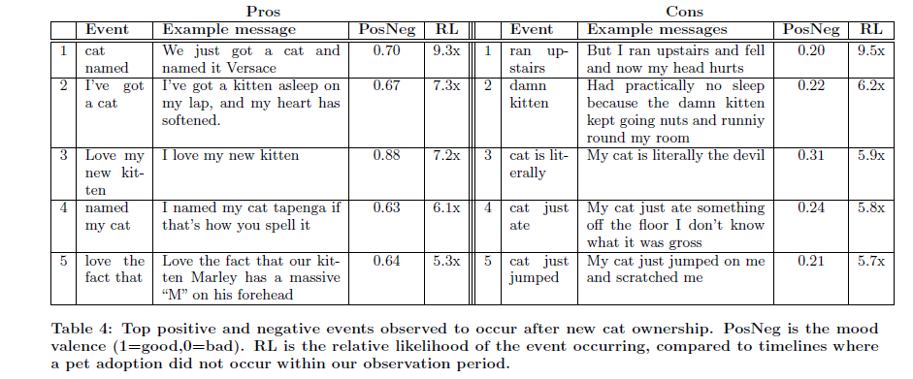
Subsequent Events and Choice Exploration

Slide 22
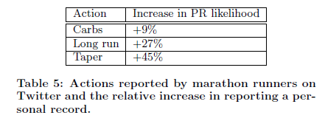
Precedent Events and Goal Achievement
Our second case study demonstrates our pipeline's ability to incorporate higher-level events, namely, marathon participation inferred from information mentioned across multiple social media messages.

Slide 23
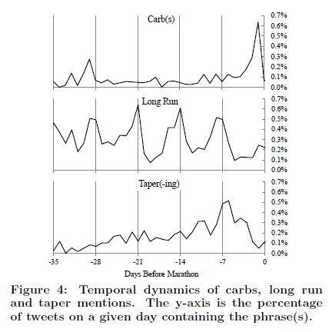
Precedent Events and Goal Achievement

Slide 24
Outline
Introduction
Method
Experiment
Conclusion

Slide 25
Conclusion
As computing devices continue to become more embedded in our everyday lives, they are mediating an increasing number of our interactions with the world around us. From helping people search for the best product to buy, to recommending a restaurant we are likely to enjoy, computing services enable users to evaluate options and take action with “one click".

Slide 26
Thanks for Listening

